Slide 1

Taxpayers Management System
By
Tikhala steven mwansambo

Slide 2
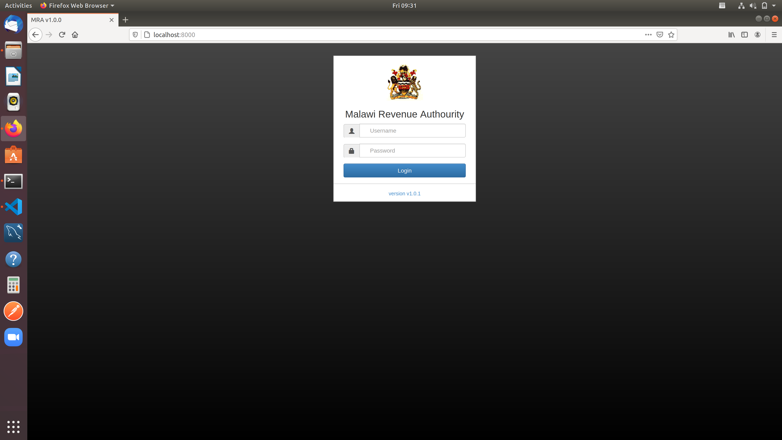
LOG IN PAGE
→ One needs to enter username and password
→ once entered, the application will authenticate with the MRA service specifically on the log in endpoint
→ Upon hitting the log in end point, the application will let user log in if successful or not depending with the response from the web service

Slide 3
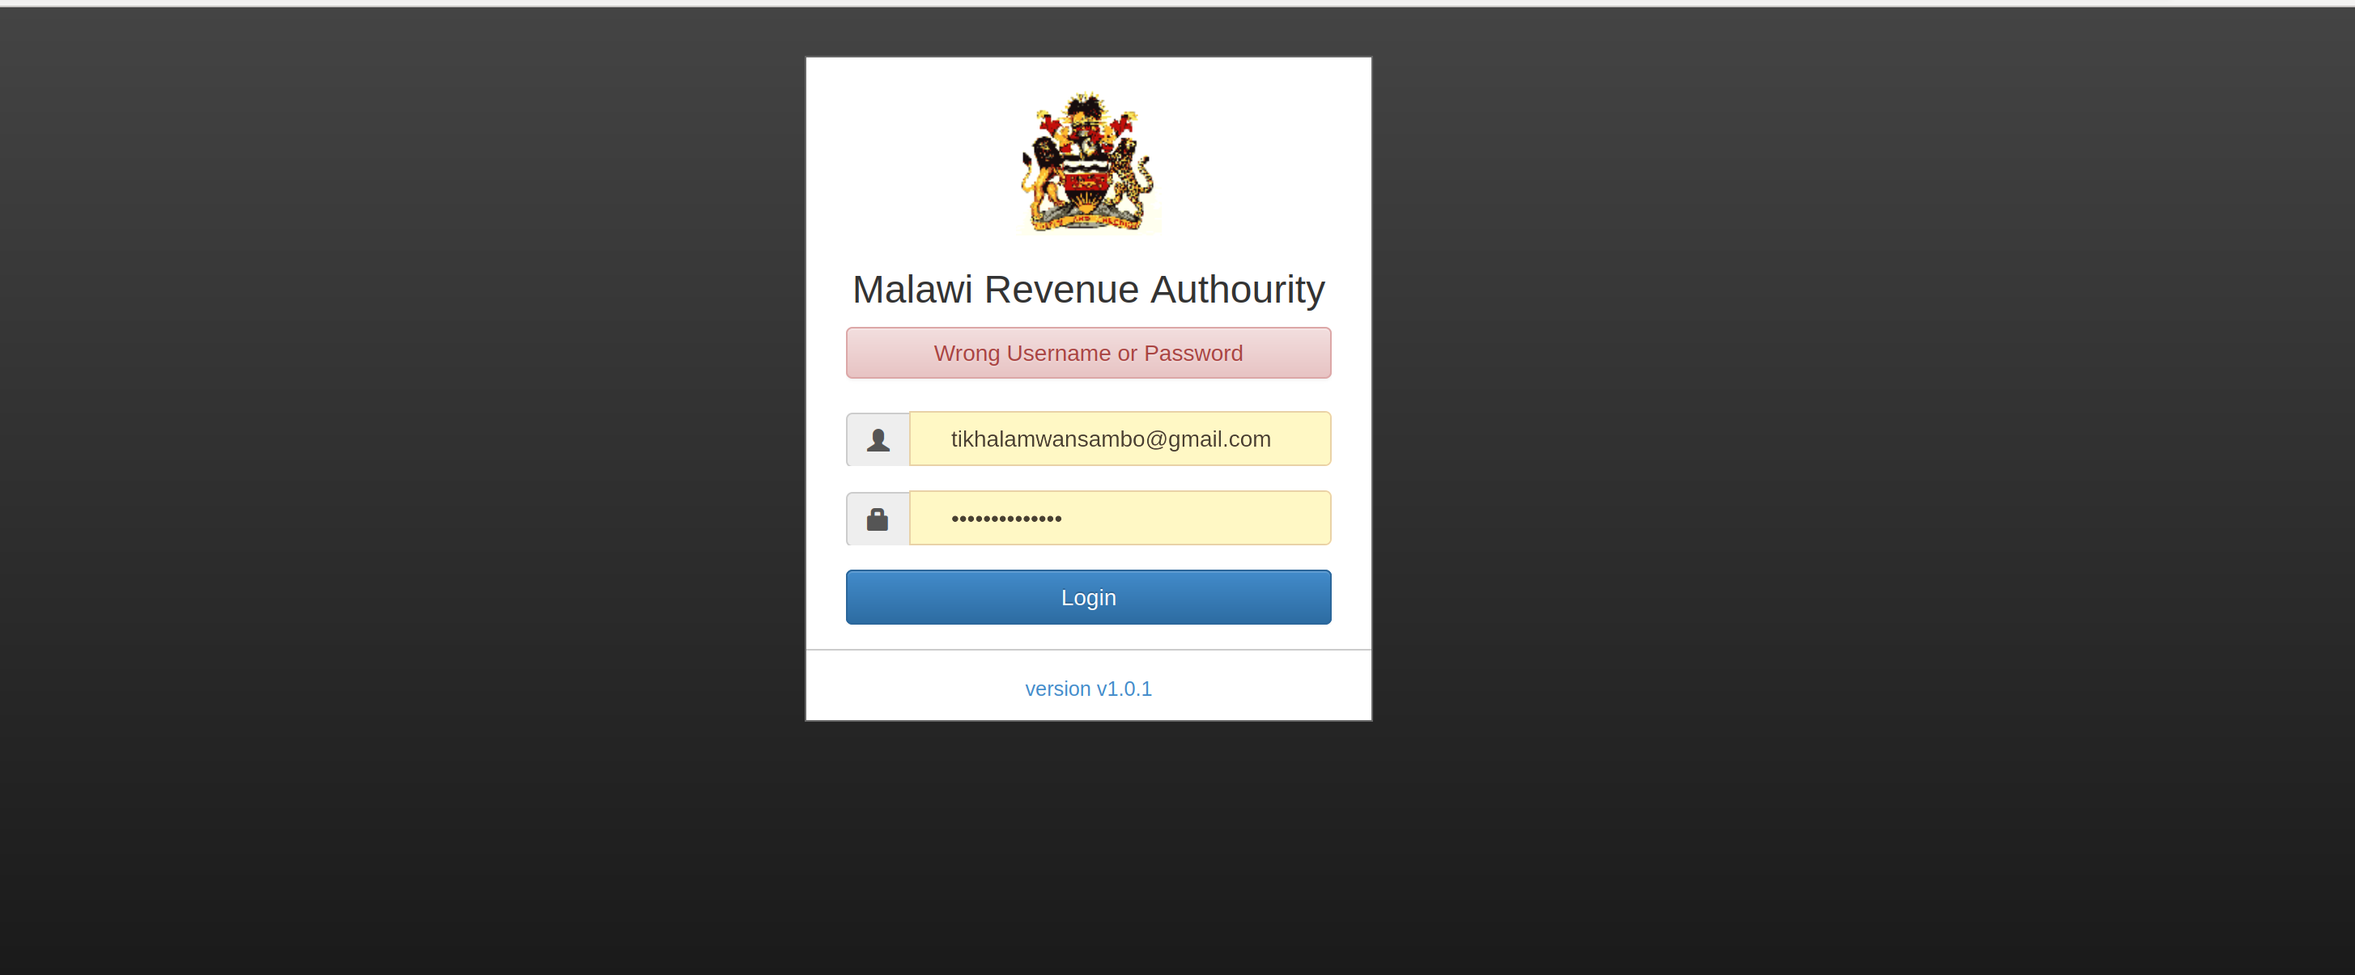
Log in attempt
→ showing wrong user or password, this is based on response from the web service

Slide 4
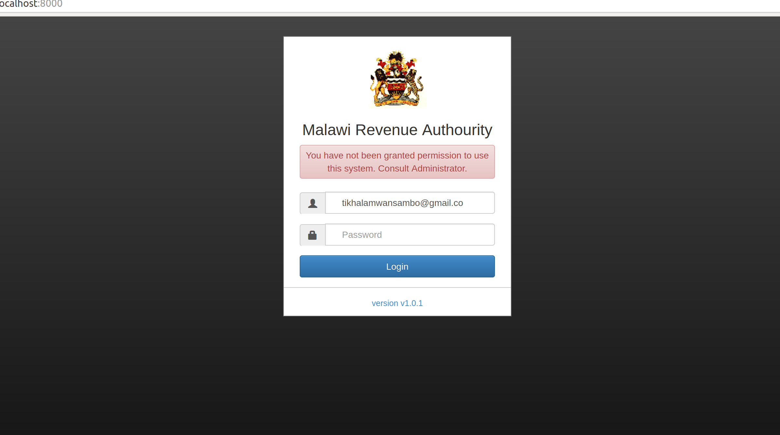
→ showing wrong username, this is also based on the web service response

Slide 5
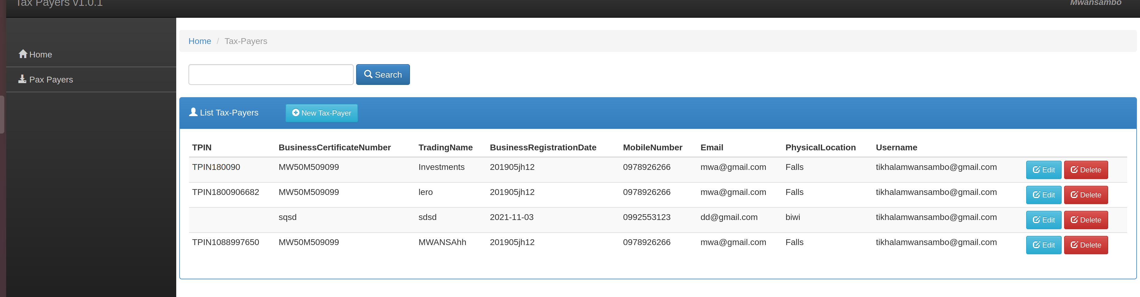
…
→ on successful log in, the above page will load, thus showing the tax payers registered by the user who have logged in.
→ when the page is loading, it consumes the web service , the get all tax payers end point
→ on each tax payer, you can do an edit or delete
again, on this page you can create a tax payer

Slide 6
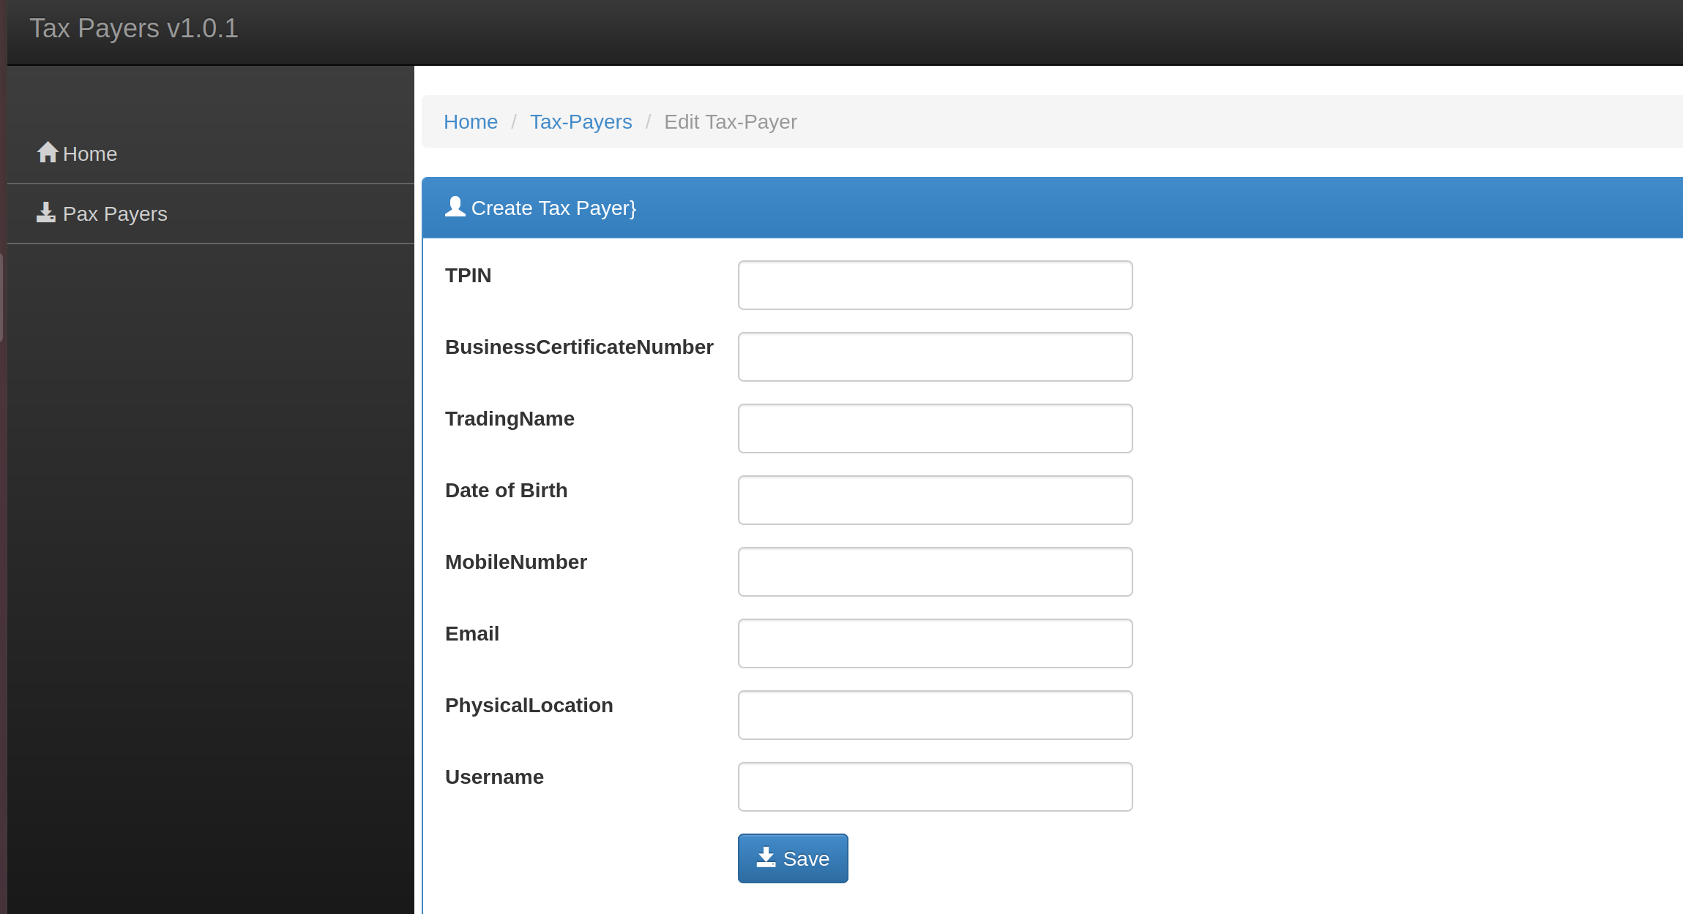
CREATE TAX PAYER

Slide 7
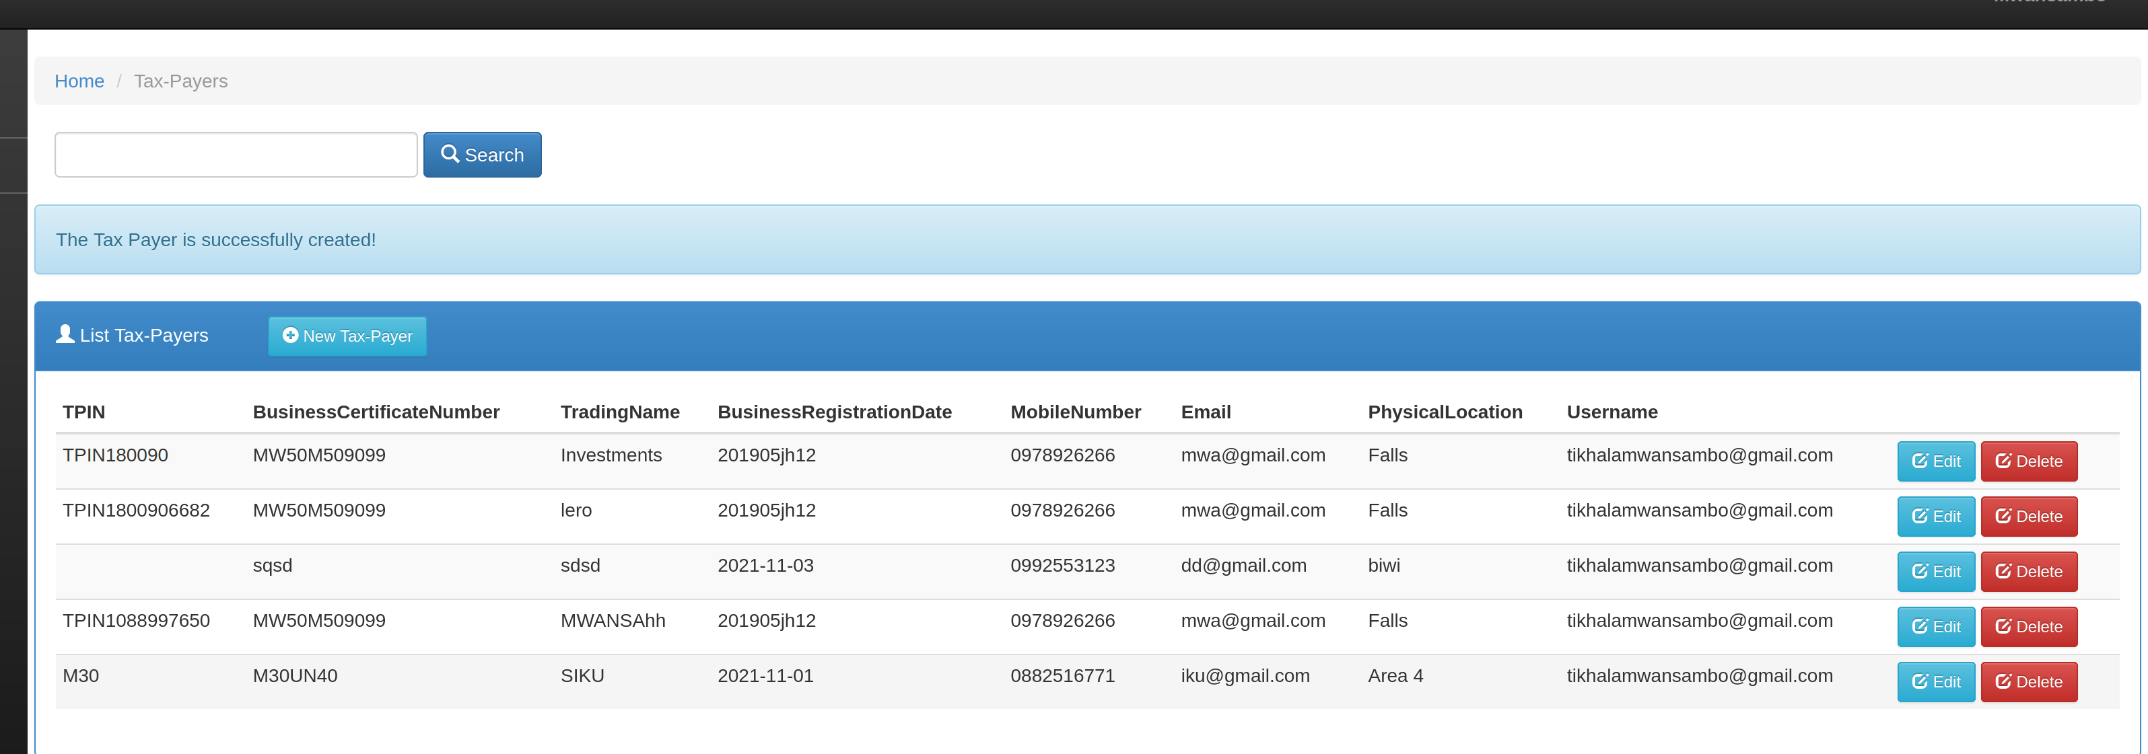
…
→ added the new tax payer, the last record → upon adding the tax payer, the application had to consume the add tax payer end point.

Slide 8
EDIT TAX PAYER
→ to edit, have to click the edit button on respective tax payer
→ then the application will load a page allowing user to do the edit
→ upon clicking the save button on this new page, the application consumes the edit end point

Slide 9

Edit taxpayer screen
→ any response got from the web service is dealt with, for example below, was trying to edit a tax payer’s TPIN. See

Slide 10
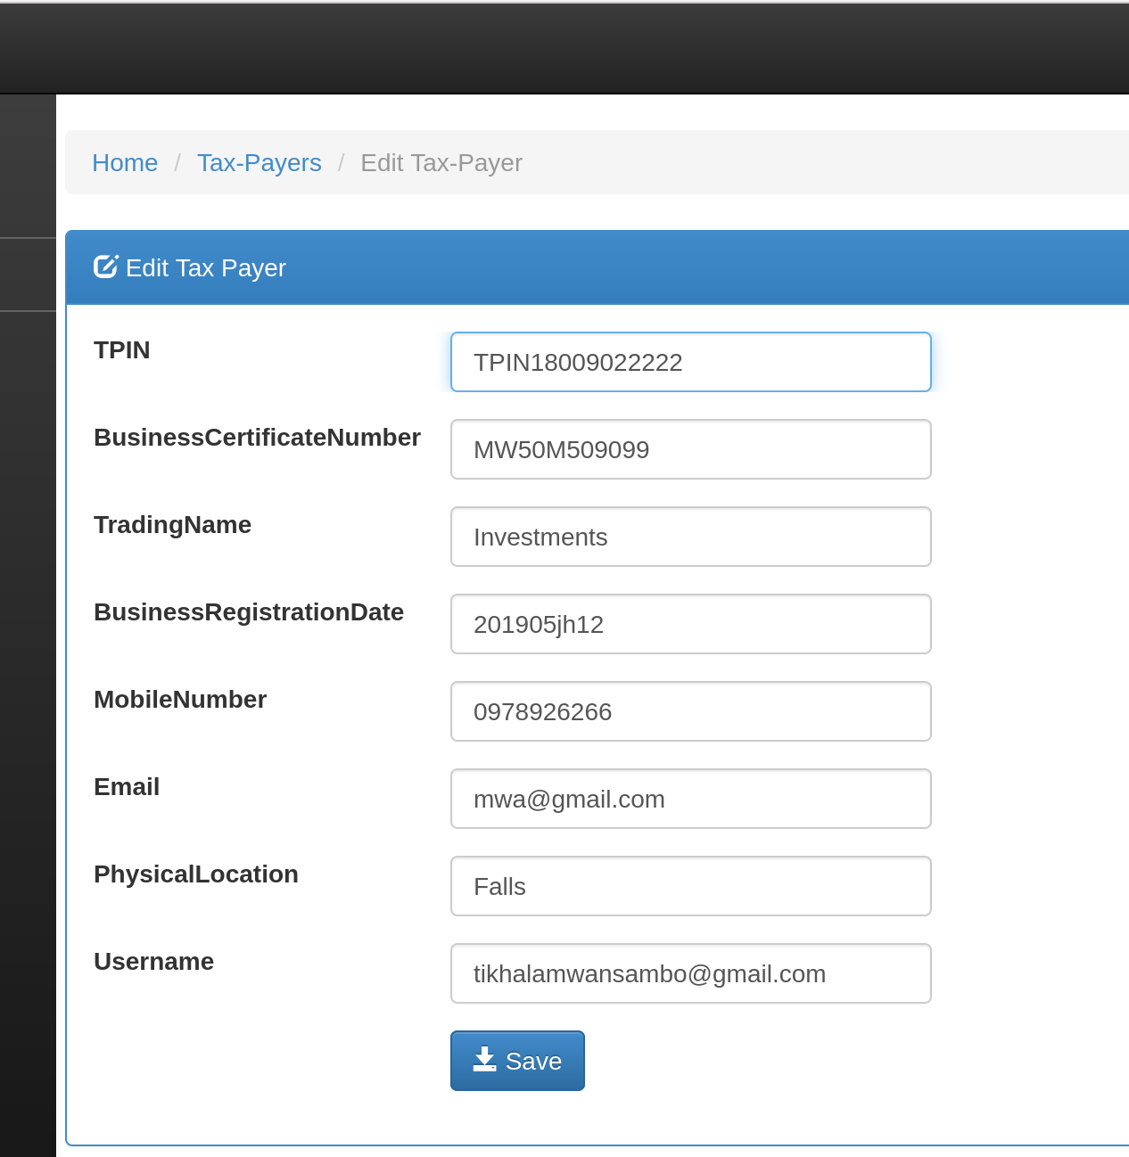
Editing tpin
→ entered any TPIN number, upon saving this is the response

Slide 11
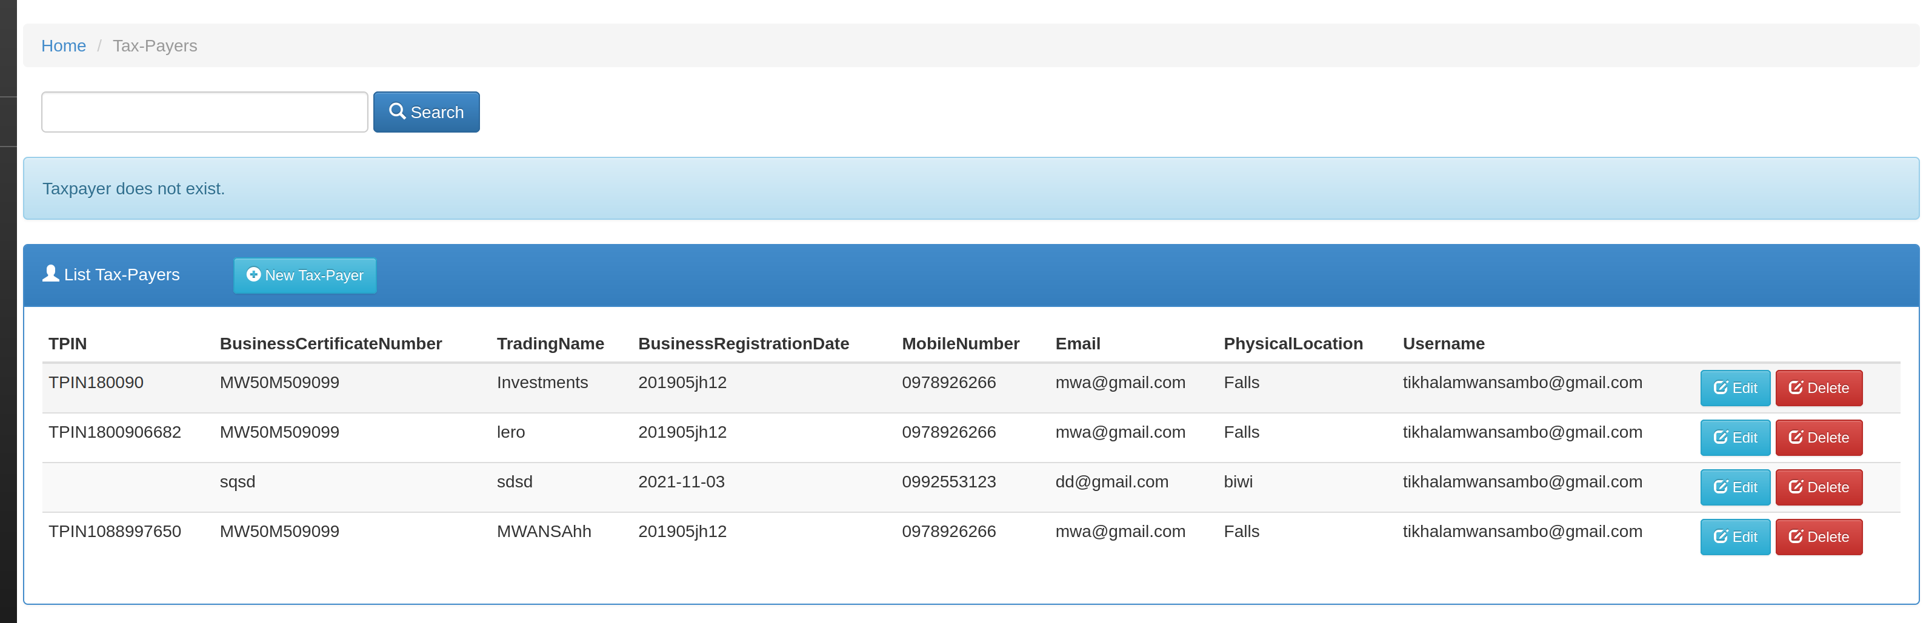
…
→ it says Tax Payer does not exist

Slide 12
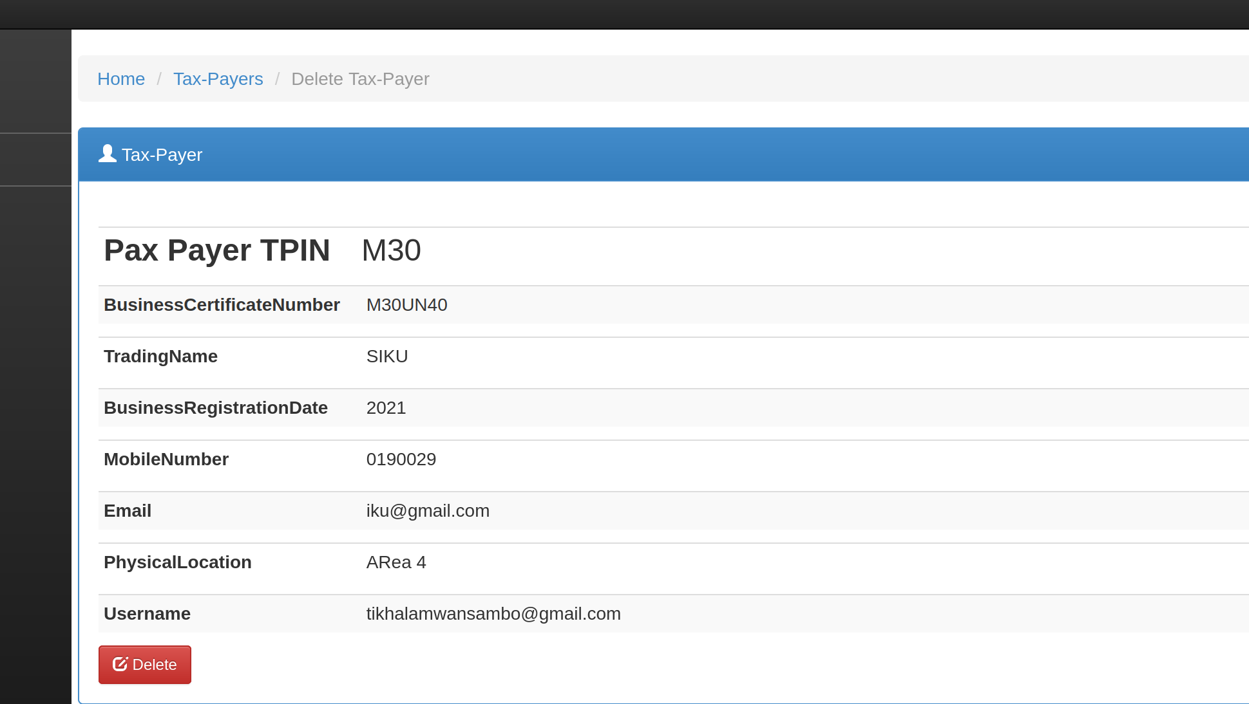
DELETE TAX PAYER
→ delete on tax payer was clicked, then the above window loaded.
→ upon clicking delete button, the application consumes the delete end point and deletes the tax payer.

Slide 13

…
→ show a successful deletion.

Slide 14
The End.!!

